Slide 1
Topic: Operations with multiple steps EQ: How do I apply BIMDAS?
Year 11 Essentials

Slide 2
Things Required For This Lesson
Interactive Notebook
Textbook: Interleaved Maths Essential Connections
Ruler, Red Pen, Pencil, Pens, Scientific Calculator
Growth mindset

Slide 3

24
7
30
Topic: Operations with multiple steps
EQ: How do I apply BIMDAS?
WICOR
This Photo by Unknown Author is licensed under CC BY-SA

Slide 4
24
7
30
Topic: Operation with multiple steps
EQ: How do I apply BIMDAS?
What does BIMDAS stand for?
B
I
M
D
A
S
rackets
ndices
ultiplication
ivision
ddition
ubtraction
WICOR

Slide 5
24
7
30
Topic: Operation with multiple steps
EQ: How do I apply BIMDAS?
How do you apply BIMDAS?
BIMDAS is the order in which mathematic operations should be done. To do the calculations we go down in the order describe below (from left to right).
We can think of this as a “staircase”.
 |  |  | Addition/Subtraction
 |  | Multiplication/Division
 | Indices
Brackets
WICOR

Slide 6
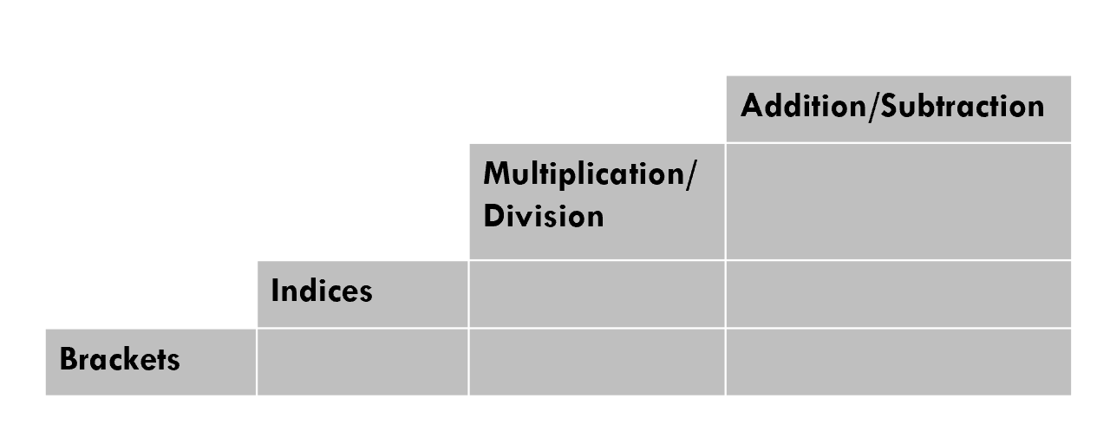



24
7
30
Topic: Division with arrays
EQ: How do I apply BIMDAS?
Applying BIMDAS
$$−2+2×5−6=$$
$$−2+10−6=$$
Steps:
Equation has no bracket and indices so move to multiplication
Once you solve the multiplication, answer it from left to right
Do the addition before the subtraction
$$8−6=2$$
WICOR

Slide 7

PRACTICE (LHS)
$10×3−16=$
$24÷4−2+12=$
$12×5−15+3−2=$

Slide 8





24
7
30
Topic: Operation with multiple steps
EQ: How do I apply BIMDAS?
Applying BIMDAS
$$2×5 (4−10÷2)$$
$$2×5 (4−10÷2)$$
$$2×5 (4−5)$$
Steps:
Look at the bracket equation first
Solve the division next
Once you solve, find the answer for the bracket.
Multiply to finish
$$2×5 (−1)$$
$$10× \left(−1\right)=−10$$
WICOR

Slide 9
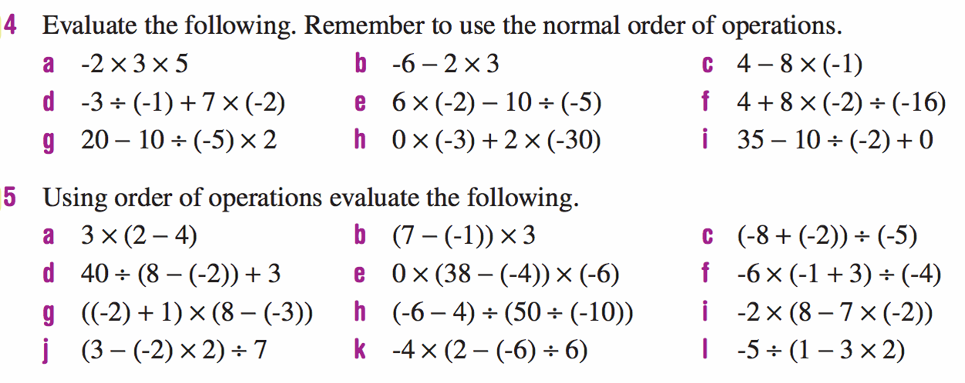
Practice (LHS)

Slide 10
Practice (LHS)
Complete Set A and B in your interleaved books (page 26)

Slide 11

Thank you
Keep up the good work!
Quote of the day –
“Good, better, best.
Never let it rest,
until your good is better,
and your better is best”

